Slide 1
Introduction to Machine Learning Neeraj Kumar Soni Data Science Professional

Slide 2
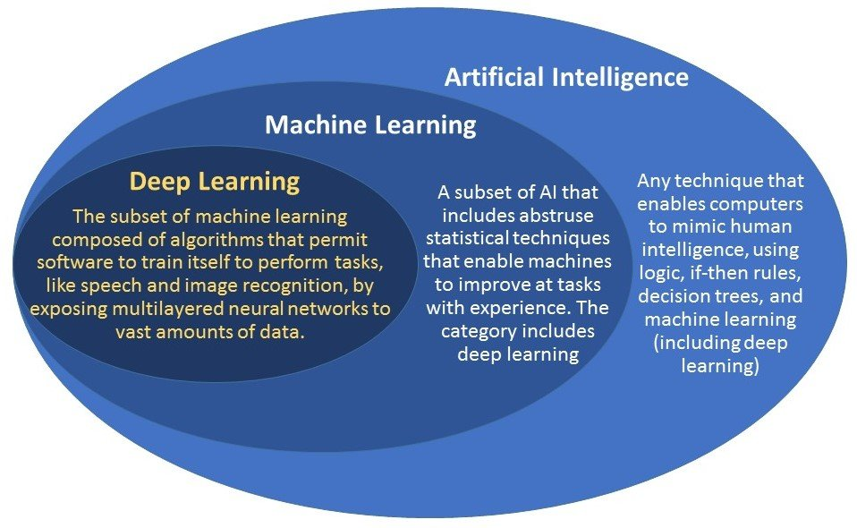
**Machine learning is an application of artificial intelligence (AI).
A similarly simplified definition is that machine learning is made up of 3 things: 1) data, 2) a model or estimator, and 3) a cost or loss to minimize

Slide 3
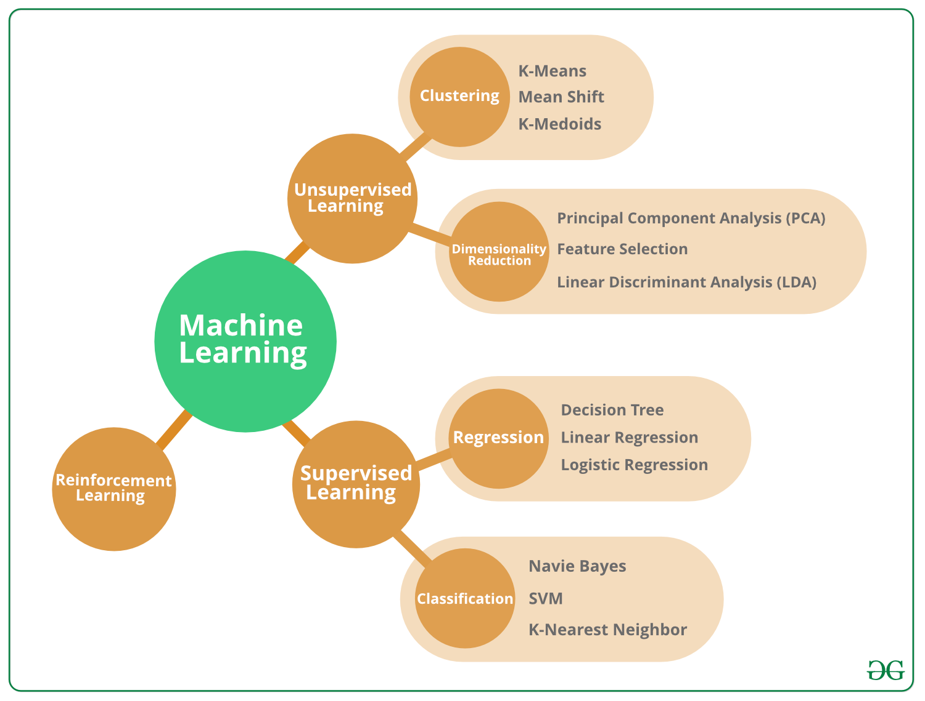
ML- Classification

Slide 4
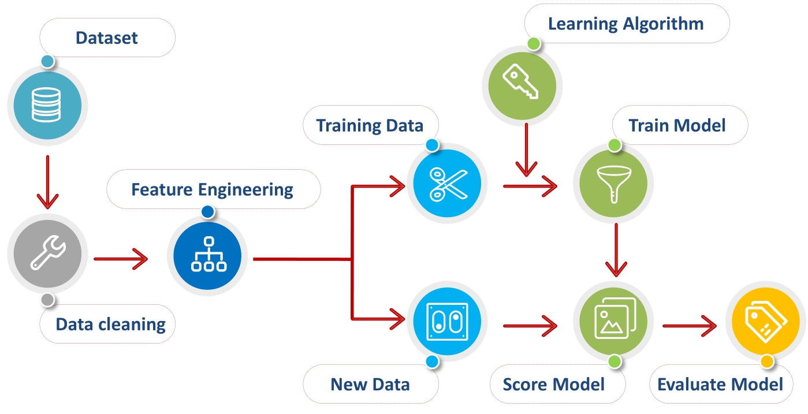
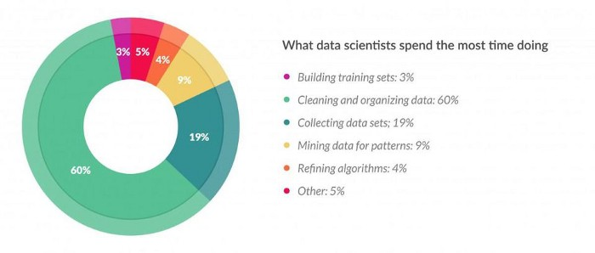
Process Flow- ML
Data Collection
Data Preparation
Feature Engineering
Algorithm Selection
Prediction & Model Evaluation
**According to Forbes Survey-Data Scientists Spend 80% of their time on data Preparation,Feature Enginerring

Slide 5
Process Flow- ML
Data collection and preparation: everything from choosing where to get the data, up to the point it is clean and ready for feature selection/engineering
a)Trend Analysis
b) Master Data Preparation
c)Data Wrangling
Feature selection and feature engineering: this includes all changes to the data from once it has been cleaned up to when it is ingested into the machine learning model
a) one hot encoding:a.1)Helps to manage your categorical data for most of the ML algorithm
a.2)enables you to group your categorical data without losing anyinformation
b) Data Scaling:-1) age and income columns are not comparable because of high deviation btw 2s
2)For ML Point we need to convert them to a comparable form.
3)continuous features become identical in terms of the range,after a scaling process
4)Min-Max normalization, substracting with mean are few method.
5)This transformation does not change the distribution of the feature
6)Outlier should be taken care of

Slide 6
Process Flow- ML
Imputation: 1) Exclude rows with NA**
2) Impute with Mean/Median
3) Max of counts for Categorical Data
Handling Outliers:1) Visualization- Best approach
2) Statiscal Method like - Std Deviation/IQR
3) Capping the data-- Don’t exclude the outlier, else just change them to the
upper or lower limit as required
Log transformation:-1)It helps to handle skewed data and after transformation
2) the distribution becomes more approximate to normal.
3) It also decreases the effect of the outliers, due to the normalization of
magnitude differences and the model become more robust.
Extracting Date/Info:Extracting the parts of the date into different columns: Year, month, day, etc.

Slide 7
Process Flow- ML
Choosing the machine learning algorithm and training our first model: getting a "better than baseline" result upon which we can (hopefully) improve
Evaluating our model: this includes the selection of the measure as well as the actual evaluation; seemingly a smaller step than others, but important to our end(confusion matrix,RMSE)
Model tweaking, regularization, and hyperparameter tuning: this is where we iteratively go from a "good enough" model to our best effort

Slide 8
Interview Questions/Basics/Suggestion
Regression is ML or not??
Difference between AI Vs ML Vs DL
***The data you apply log transform must have only positive values, otherwise you receive an error. Also, you can add 1 to your data before transform it. Thus, you ensure the output of the transformation to be positive.
Please create “Github” Account
Please create “AV” Account

Slide 9
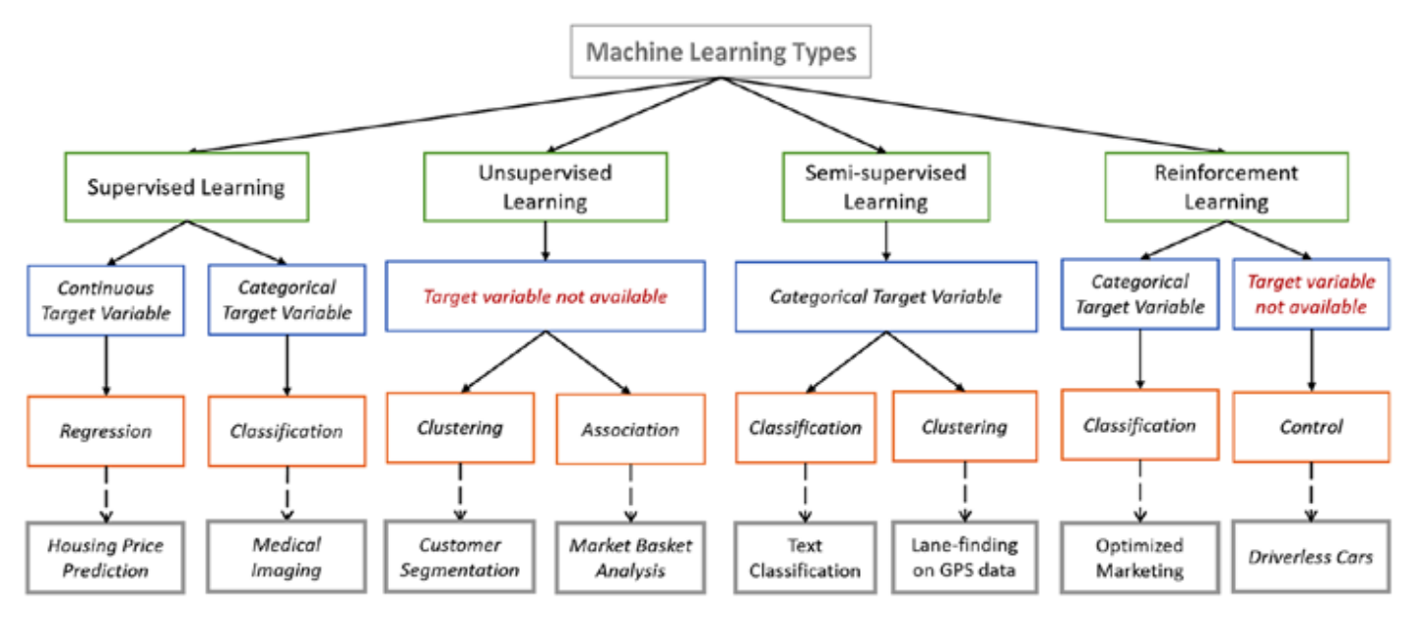
Additional- Charts
Log Transformation- data['log+1'] = (data['value']+1).transform(np.log)
Imputation-data = data.fillna(data.median())
Outlier=#Dropping the outlier rows with standard deviation factor = 3 upper_lim = data['column'].mean () + data['column'].std () * factor lower_lim = data['column'].mean () - data['column'].std () * factor data = data[(data['column'] < upper_lim) & (data['column'] > lower_lim)]
encoded_columns = pd.get_dummies(data['column']) data = data.join(encoded_columns).drop('column', axis=1)
Scaling=data = pd.DataFrame({'value':[2,45, -23, 85, 28, 2, 35, -12]}) data['normalized'] = (data['value'] - data['value'].min()) / (data['value'].max() - data['value'].min())

Slide 10
Additional- Charts
Artificial Intelligence | Machine learning
Artificial intelligence is a technology which enables a machine to simulate human behavior. | Machine learning is a subset of AI which allows a machine to automatically learn from past data without programming explicitly.
The goal of AI is to make a smart computer system like humans to solve complex problems. | The goal of ML is to allow machines to learn from data so that they can give accurate output.
In AI, we make intelligent systems to perform any task like a human. | In ML, we teach machines with data to perform a particular task and give an accurate result.
Machine learning and deep learning are the two main subsets of AI. | Deep learning is a main subset of machine learning.
AI has a very wide range of scope. | Machine learning has a limited scope.
AI is working to create an intelligent system which can perform various complex tasks. | Machine learning is working to create machines that can perform only those specific tasks for which they are trained.
AI system is concerned about maximizing the chances of success. | Machine learning is mainly concerned about accuracy and patterns.
The main applications of AI are Siri, customer support using catboats, Expert System, Online game playing, intelligent humanoid robot, etc. | The main applications of machine learning are Online recommender system, Google search algorithms, Facebook auto friend tagging suggestions, etc.
On the basis of capabilities, AI can be divided into three types, which are, Weak AI, General AI, and Strong AI. | Machine learning can also be divided into mainly three types that are Supervised learning, Unsupervised learning, and Reinforcement learning.
It includes learning, reasoning, and self-correction. | It includes learning and self-correction when introduced with new data.
AI completely deals with Structured, semi-structured, and unstructured data. | Machine learning deals with Structured and semi-structured data.

